Slide 1
Overview of the Modern Microsoft Platform
Presenter Name

Slide 2

Devices
Services
Notes:
Key Points:
Increase in devices and rise of services have dramatically impacted developers
Both are helping blur the line between “consumer” and “enterprise”.

Slide 3







client/server
device/services
Notes:
Developers can be roughly subdivided into two distinct camps: 1.) developers writing apps against the existing, client/server application pattern, and 2.) developers writing apps against the emerging, device/services application pattern.
The existing app pattern is line-of-business (LOB) apps, forms over data, and web implementations of this are generally static pages
The new app pattern is either device-first, in which you have a multi-device, multi-screen experience, that takes a cloud service dependency, or cloud-first, in which the core asset is a cloud service which surfaces as an experience on a device (or multiple devices).

Slide 4
Devices

Slide 5
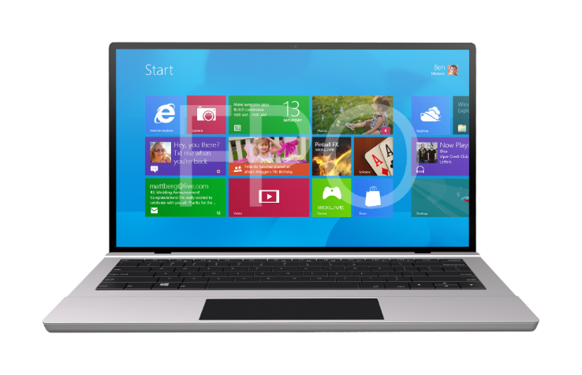
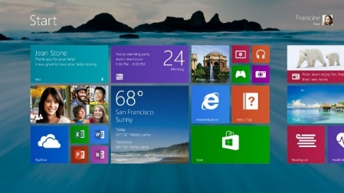
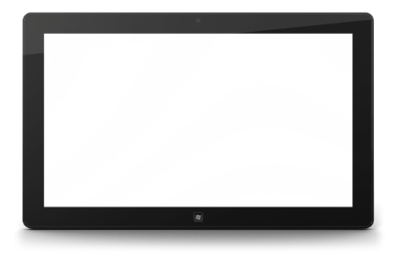

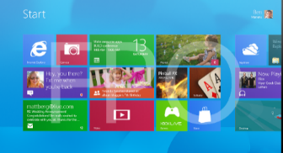

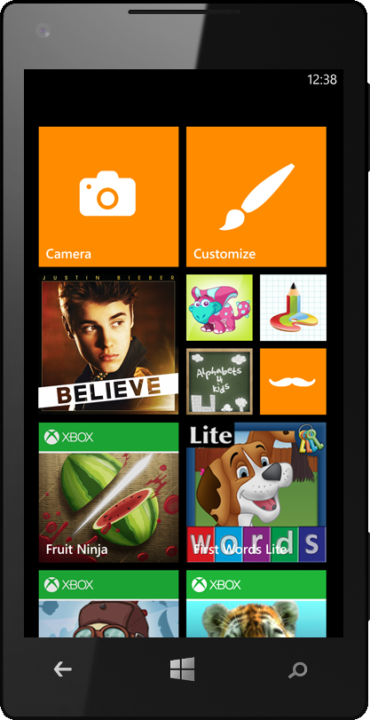
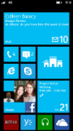
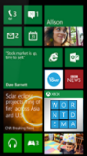
Touch-first experience
Integrated stores
Existing skills, code
Developing for Windows
Notes:
Microsoft’s device strategy is anchored in Windows, and with Windows 8.1, we’re continuing to build on the bold vision we introduced with Windows 8. Not only did Windows 8 represent the most significant revision to the developer platform since the introduction of Win32 in Windows 95, we’ve also made a bold statement about the future of how people will use devices … touch-first, full-screen experiences with fully integrated cloud services, delivered across desktops, notebooks, tablets, and all-in-ones.

Slide 6
Windows
Apps
XAML
HTML
C
C++
C#
Visual Basic
JavaScript
Windows Runtime
Developing for Windows
Notes:
Chances are you already have the skills to build apps and experiences on the Microsoft platform.

Slide 7

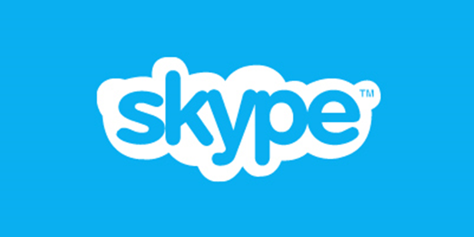
























IMAG PIP area
IMAG PIP area
CLOSED CAPTIONING TEXT AREA
Notes:
Microsoft is dedicated to top apps, total apps, quality apps

Slide 8
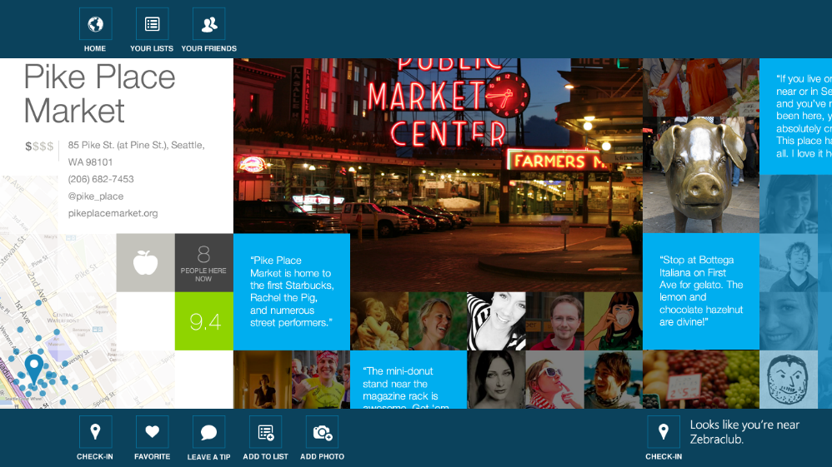


“The first serious tablet version of the check-in app is here.” - Harry McCracken, Time
CLOSED CAPTIONING TEXT AREA
Notes:
Exciting things here today, coming soon and in the works

Slide 9
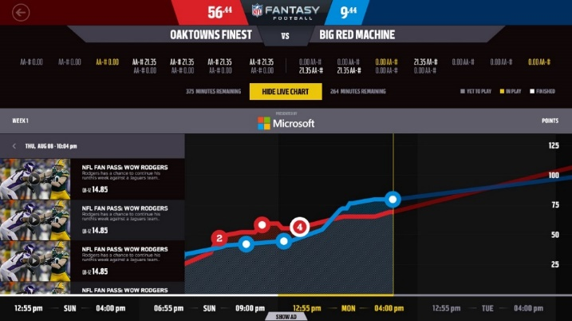


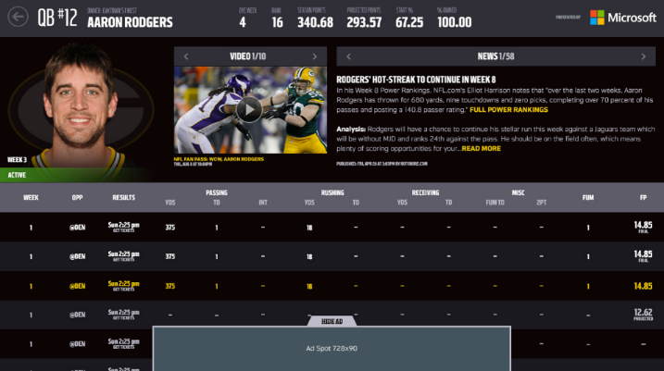
Fantasy Football
CLOSED CAPTIONING TEXT AREA
Notes:
NFL Fantasy Football:
The ONLY Official, native, NFL Fantasy football app outside of their NFL.com browser experience. NFL Fantasy allows the NFL.com registered user to manage all aspects of their fantasy league once the draft for their league has taken place. Only available on Windows 8, nothing on iPad or Android tablet. The iPhone and Android phone apps are just web views that load their mobile site.

Slide 10


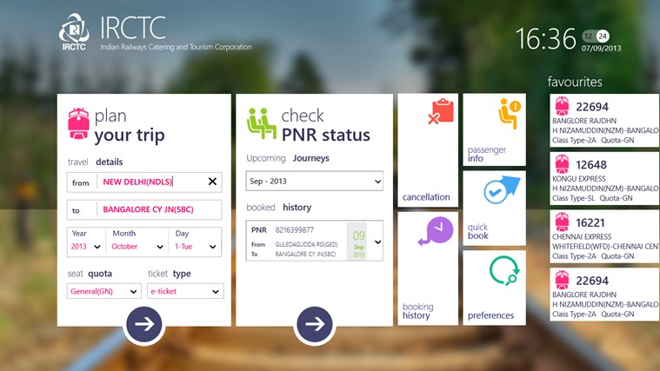
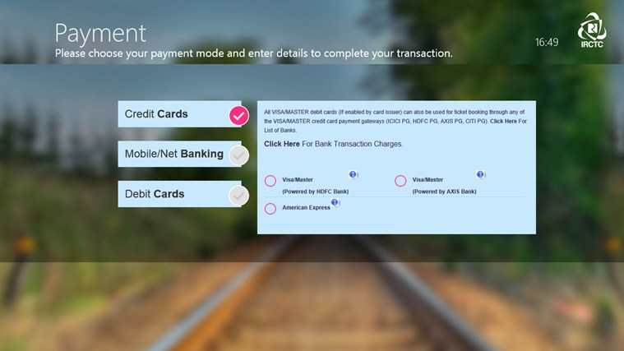
“This might be the biggest coup for Microsoft in India. IRCTC, the notorious Indian Railways train ticket booking website known for its crashes and slowness under usual heavy Indian loads has received an exclusive app for the Windows Phone 8 and Windows 8 platforms, developed in partnership with Microsoft.”
– Bharadwaj, Fonearena
“Electronic tickets account for approximately 48 per cent of the tickets sold every day… making the website figure in the list of top ranking e-commerce sites in the country.”
– The Economic Times
CLOSED CAPTIONING TEXT AREA
Notes:
Indian Railway Catering and Tourism Corporation (Government of India Enterprise) is the only online passenger reservation system for booking train tickets for the world’s largest railways (by rail network & passengers)

Slide 11

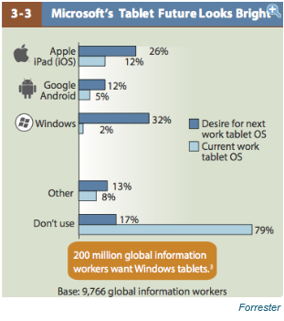


2%
200 million global information workers would like to use a Microsoft Windows tablet for work
32%
12%
26%
5%
12%
Current work tablet
Desired next work tablet
Windows 8 in the Enterprise
Forrester
Notes:
From security, familiar programs and more powerful software . . . when needing to get real work done, more people in business want to work on a Windows tablet
Forrester 2013 Mobile Workforce Adoption Trends: Forrester surveyed nearly 10,000 enterprise employees in 16 countries and found that 32 percent want a Windows tablet to use for work. This compares to 26 percent who want an iPad and 12 percent who want an Android tablet.
http://www.businessinsider.com/200-million-want-a-microsoft-tablet-2013-2

Slide 12

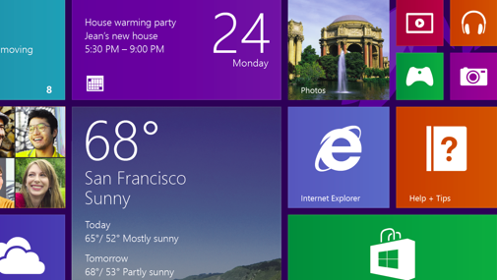
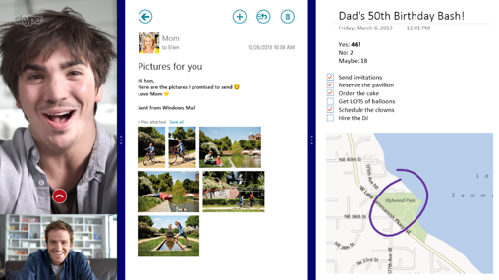
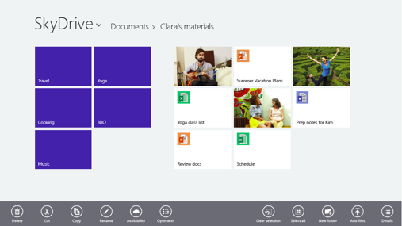
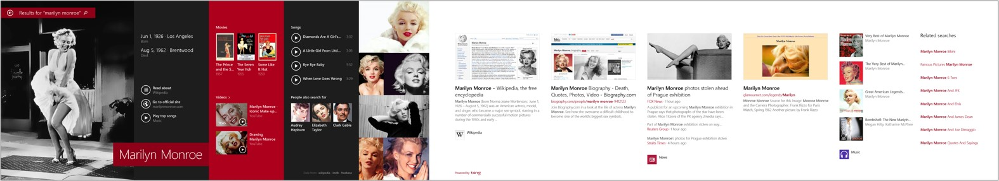
8.1 More powerful and efficient
Personalized start and lock screens
New live tile sizes, including large
Apps share the screen
Deep SkyDrive integration
Rich, integrated search driven by Bing

Slide 13
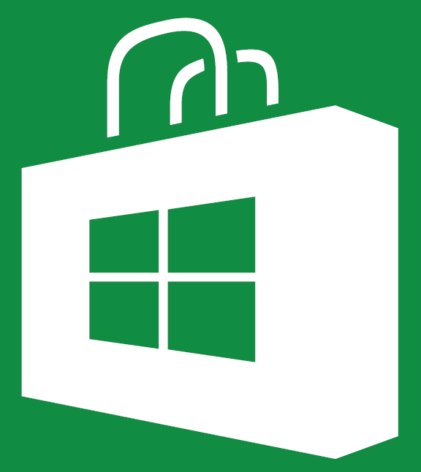


Notes:
Windows Store
Super flexible terms to enable developers to make money – this is not a strength for apple, frankly
70/30 split, but a low bar of $25K in revenue to accelerate that to 80/20 … apps that do well and achieve popularity with users create a path for the developer to make more money
Use your own commerce platform … it goes to 100% - developers keep everything
In-app purchasing is no problem
3rd-party ad controls are no problem – you want to use Google for ads? Totally fine
Windows 8.1 brings store improvements including: automatic app updates; proxy authentication for enterprise scenarios; support for large in-app purchase catalogs; store results will be powered by Bing analytics and new and improved store catalog pages

Slide 14
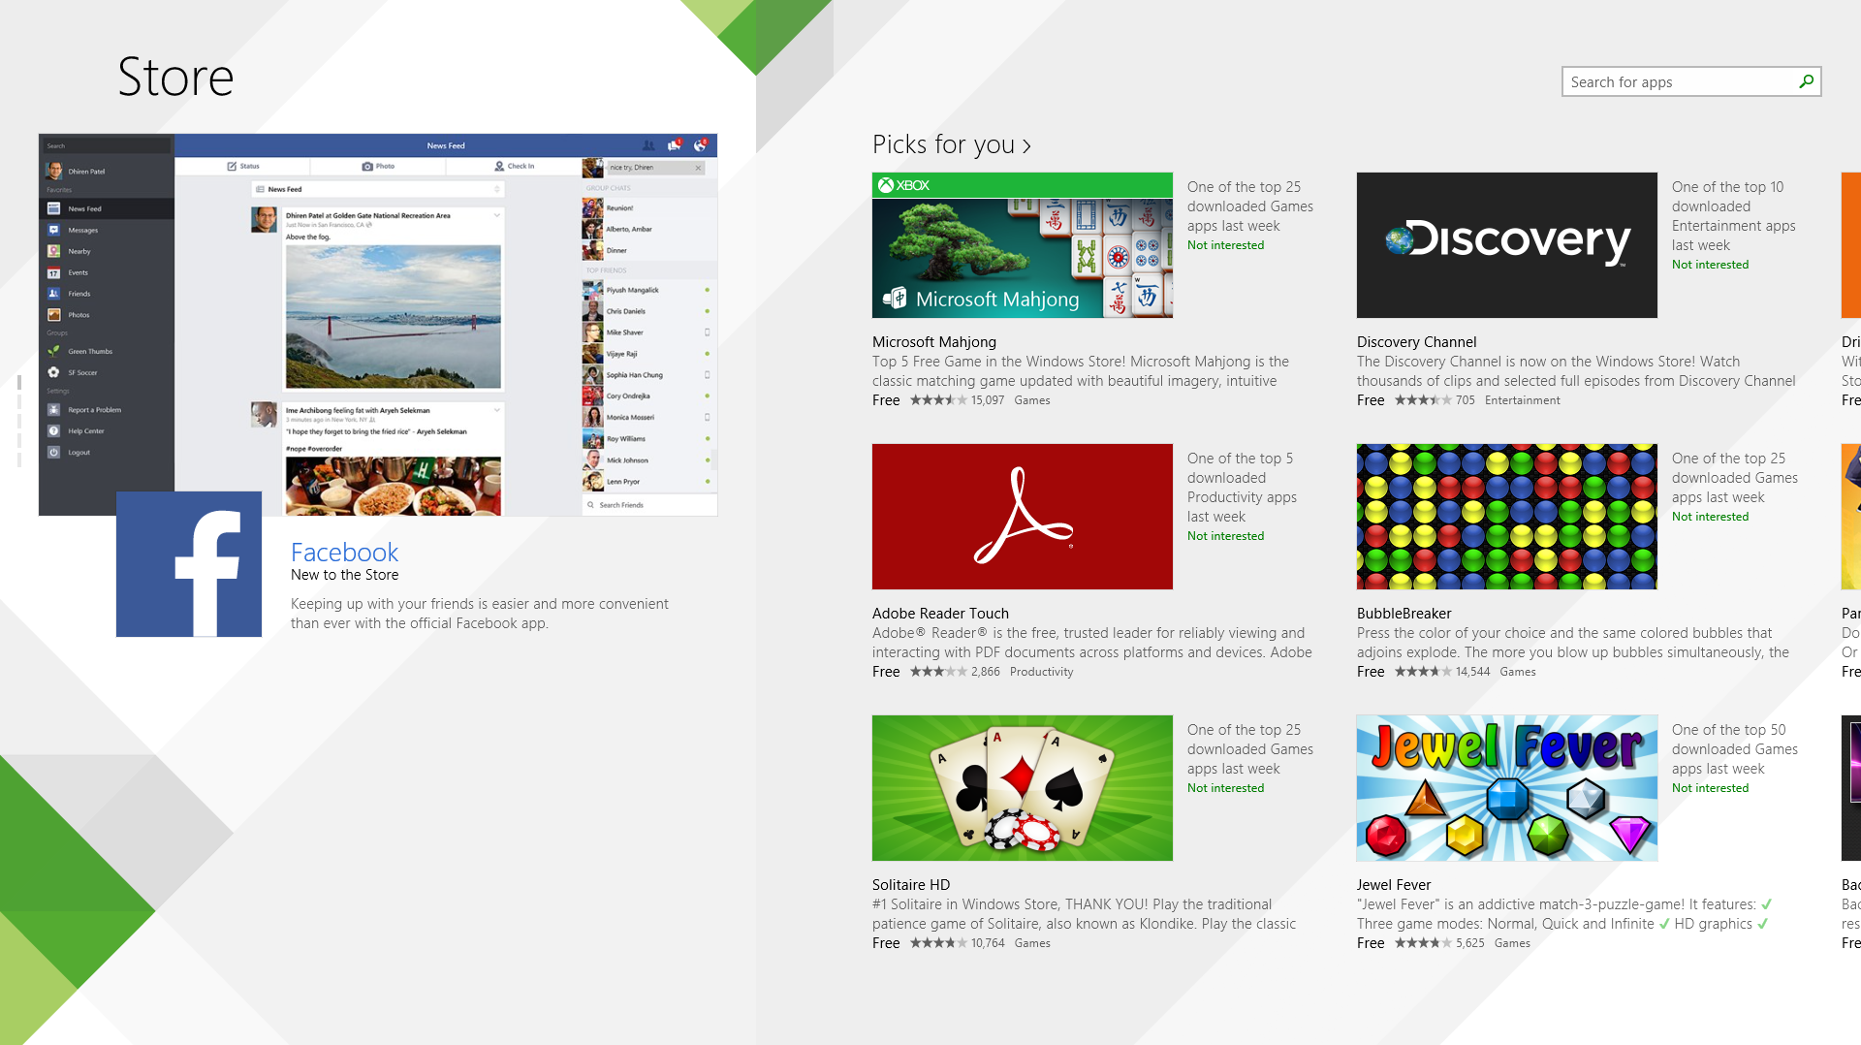

Slide 15
Services

Slide 16






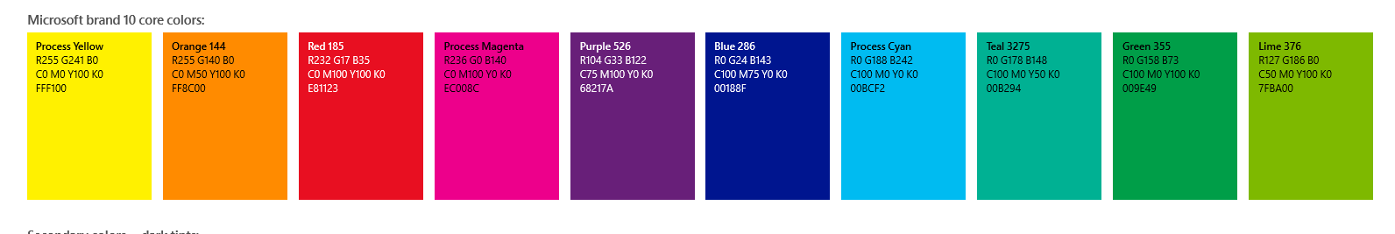



Proven experience
Azure
Bing holds 17.86 percent of US market share
Nearly 50 million Office Web Apps users
Skype users spend up to 2 billion minutes per day using the service
Over 250 million people have a SkyDrive
1.5 Billion games of Halo
On average, over 1,000 new customers sign up for Windows Azure every day
48 Million Subscribers
299 Million connected users
Yammer now has over 7 million registered users
11 billion stored photos
Outlook.com has over 400 million active users and is the world’s fastest growing email service
1 Billion mobile notifications a month
50 percent of Fortune 500 companies use Azure
Xbox delivered over 18 billion hours of entertainment in 2012
Notes:
One of the other things that drives us and is at play for us on a daily basis is the feedback cycle of our first-party workloads. We have perhaps the most diverse set of first-party workloads – the SaaS applications we run ourselves -- at Microsoft.

Slide 17



Windows in the cloud
Notes:
For Microsoft, the runtime for the cloud OS is a set of capabilities that will enable development against the cloud design point and new app patterns. It’s comprised of a core set of capabilities such as virtual machines, websites, and media & mobile services that developers can extend through higher level services such as identity, data, and integration. In addition, application/SaaS-level extensibility also enables an increasingly relevant class of apps, especially for business application developers. As developers shift toward the emerging app pattern, this portfolio of capabilities will become the baseline set of requirements, and only Microsoft has this portfolio today.

Slide 18
public
cloud
.NET
Hyper-V
Visual Studio
System Center
Active Directory
hybrid cloud
private cloud
Notes:
Key Points:
Windows is our platform for both devices and services, server and cloud
Common thread across all of Windows – PC, Tablet, Phone, Server, Cloud, Data – It is all Windows
What we learn from hosting some of the largest services in the world we implement in our products.

Slide 19
Programming Model + Tools
Identity
Integration
Data
IaaS + PaaS
Microsoft Cloud Infrastructure
Notes:
We're building a very robust Windows Azure app model.
At the bottom of the app model is our infrastructure. Datacenters. Edge network. At the compute-storage-network level, at the datacenter scale and multi-datacenter scale. And that really is the operating system that is Windows at the backend, at this point, which in fact shipped even in Windows Server for a different scale unit.
Application containers. And we're unique in providing a complete IaaS plus PaaS, which is infrastructure as a service and platform as a service capability when it comes to application containers. Everything from virtual machines with full persistence to websites to mobile to media services to cloud services. So that capability is what allows you to build these rich applications and very capable applications.
Beyond that, we also believe that we can completely change the economics of what complex applications have needed in the past. We can take both productivity around development and continuous deployment and cycling through your code of any complex application and reduce it by orders of magnitude.
Take identity. We are going to change the nature of how people set up your applications to be able to accept multiple identities, have strong authentication and authorization, how to have a directory with rich people schema underneath it that you can use for authorization.
Integration, take all of the complex business-to-business or EI type of project that you have to write a lot of setup before you even write the core logic; we want to change the very nature of how you go about that with our integration services.
And when it comes to data, there is not a single application now that doesn't have a diverse set of needs when it comes to the data from everything from SQL to NoSQL, all types of processing from transactional to streaming to interactive BI to MapReduce. And we have a full portfolio of storage technologies all provided as platform services so that your application development can be that much richer and that much easier.
Now, obviously, the story will not be complete without great tooling and great programming model.

Slide 20




extend
dev, test, run
mobile
web
Notes:
There are a number of scenarios where you can quickly take advantage of the power of Windows Azure:
Extend your infrastructure:
Windows Azure Infrastructure services allows you to spin up or tear down virtual machines easily.
Dev, Test, run your apps
Dev and test is critical step of building apps, and you can readily use VMs for this.
In addition, there are ready- to-use-services in Windows Azure such as caching or NoSQL databases or SQL Database which eliminate any set-up time when creating apps.
Web
Windows Azure also provides platform as a service solutions, such as Windows Azure Web Sites.
Mobile Windows Azure Mobile Services makes it fast and easy to build cross-platform mobile apps that scale. This is a turnkey solution for storing data in the cloud, authenticating users, sending push notifications and adding server-side business logic.

Slide 21








●
Open Platform

Slide 22
Common Core
Notes:
We’re trying to make it easier for you as a developer to target as many devices as possible and reuse as much code as possible. You can see this in the shared kernel between Windows 8.1 and Windows Phone which provides a consistent networking stack and graphics. You can also see this in the use of IE across phone, PC and Xbox.

Slide 23







Programming skills
Development tools
Languages, frameworks
Components
Runtimes
Notes:
Key Statements:
Another key attribute of our platform is the concept of common core, which provides unique opportunity for developers. No competitor can match this.
Our Windows platform spans devices and cloud services, including Windows, Windows Phone, Windows Azure, Windows Server, Office, Bing, Xbox, Visual Studio and other tools and technologies.
With common core, developers have the ability to take code, skill set, programming languages, and tools across PC, tablet, phone, and handheld device.
In Enterprise space the deployment choice (public, private, hybrid) and enterprise grade credibility are key tenets for LOB applications.
For commercial developers, on the other hand, the size of potential market combined with faster development paves an easier path to commercial success.

Slide 24

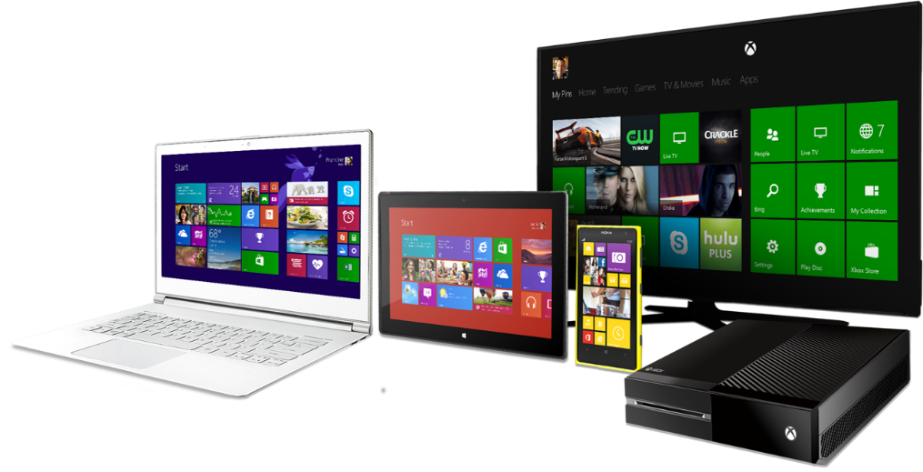
Great device experiences …
… powered by services
in the cloud

Slide 25

Create new experiences
Reach more people
Better economics
Use what you know
Notes:
Key Statements:
There are four big reasons developers (and businesses) should build on the Microsoft platform:
You can more easily create new and differentiated experiences on a new range of devices. From our Windows user experience, to our services in the cloud, to the rich device ecosystem that exists around Windows, the marriage of HW and SW creates more opportunities for developers than ever before.
Reach more people. From living rooms with Xbox, to phones, cars and kiosks, our platform can help you reach more people in more places. With hundreds of millions of new and existing devices that can run Windows the number of people you can reach with is growing daily.
Better Economics - with Microsoft Stores integrated into the device experience, a massive customer base is easily accessible and only a click away. Combined with flexible terms (ad engine, in-app purchase, commerce platform), and favorable rev. sharing on Windows when > $25K, our platform provides better economics than or competitors.
Use what you know. From the latest web technologies to existing programing languages, chances are most developers already have the skills to build apps and experiences on our platform, with language and skills commonality across PC, tablet, phone, server, and cloud. This is the case for Microsoft as well as open source technologies supported on our platform.

Slide 26
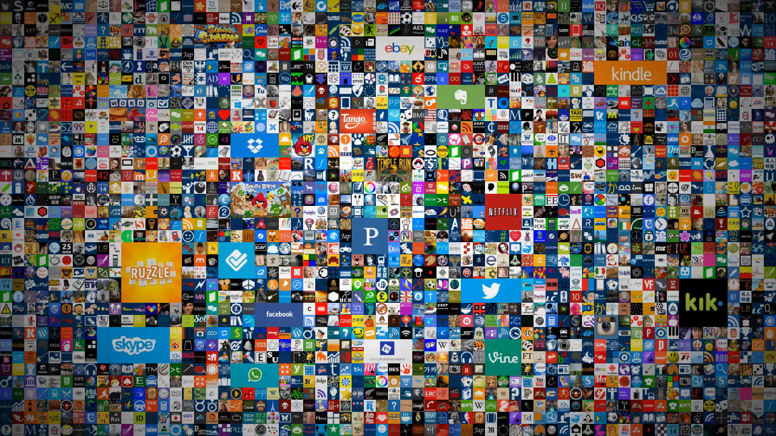

© 2013 Microsoft Corporation. All rights reserved. Microsoft, Windows and other product names are or may be registered trademarks and/or trademarks in the U.S. and/or other countries.
The information herein is for informational purposes only and represents the current view of Microsoft Corporation as of the date of this presentation. Because Microsoft must respond to changing market conditions, it should not be interpreted to be a commitment on the part of Microsoft, and Microsoft cannot guarantee the accuracy of any information provided after the date of this presentation. MICROSOFT MAKES NO WARRANTIES, EXPRESS, IMPLIED OR STATUTORY, AS TO THE INFORMATION IN THIS PRESENTATION.

